Slide 1

Course : COMP6232 / Human - Computer Interaction
Year : 2016
DESIGN, PROTOTYPING, AND CONSTRUCTION
SESSION 10

Slide 2
LEARNING OUTCOMES
LO 4: Design the user requirements with interaction styles

Slide 3
OUTLINE
^{Introduction}
^{Prototyping and Construction}
^{Conceptual Design}
^{Physical Design}
^{Using Scenarios in Design}
^{Using Prototypes in Design}
^{Support for Design}
^{Colours}

Slide 4
INTRODUCTION
There are two types of design :
  Conceptual
  Physical
For users to evaluate the design of an interactive product effectively, designers must prototype their ideas.
There are two distinct circumstances for design :
  Starting from the scratch
  Modifying an existing product.

Slide 5
^{PROTOTYPING AND}
^{CONSTRUCTION}
A Prototype is one manifestation of a design that allows stakeholders to interact with it and to explore its suitability.
A prototype can be anything from a paper-based storyboard through to a complex piece of software and from a cardboard mockup to a molded or pressed piece of metal.
Why Prototype ?
  A useful aid when discussing idea with stakeholders
  A communication device among team members.
  An effective way for designers to explore design ideas.

Slide 6
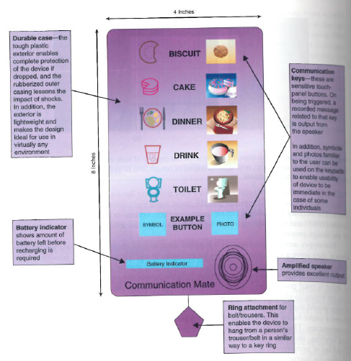
^{PROTOTYPING AND}
^{CONSTRUCTION}
An example of prototype : A paper-based prototype of the design for a handheld device to help an autistic child communicate. ( Fig 10.01)
Figure 10.01 A paper-based prototype

Slide 7
Low-Fidelity Prototyping
^{PROTOTYPING AND}
^{CONSTRUCTION}
A low-fidelity prototypes are useful because they tend to be simple, cheap, and quick to produce.
Low-fidelity prototypes are never intended to be kept and integrated into the final product.
They are for exploration only.

Slide 8
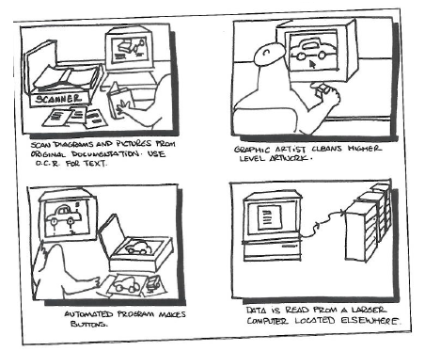
^{PROTOTYPING AND}
^{CONSTRUCTION}
Example of Low-Fidelity Prototypes :
  Storyboarding
    Consist of a series of sketches showing how a user might progress through a task using the product under development. ( See Fig 10.02)
Figure 10.02 An example Storyboard

Slide 9
^{PROTOTYPING AND}
^{CONSTRUCTION}
Example of Low-Fidelity Prototypes :
  Sketching :
    Low-fidelity prototyping often relies on hand-drawn sketches
    If you are sketching an interface design, then you need to draw various icons, dialog boxes, and so on.
  Prototyping with index card
    Using index cards ( small pieces of cardboard about 3 x 5 inches) is a successful and simple way to prototype an interaction, it is used commonly when developing websites.

Slide 10
^{PROTOTYPING AND}
^{CONSTRUCTION}
Example of Low-Fidelity Prototypes :
  Wizard of Oz
    It assumes you have a software-based prototype.
    The user interact with the software as though interacting with the product.

Slide 11
High-Fidelity Prototyping
^{PROTOTYPING AND}
^{CONSTRUCTION}
It uses materials that you would expect to be in the final product and produces a prototype that looks like final thing.
For example : a prototype of a software system developed in Visual Basic is higher fidelity than a paper-based mockup
High-fidelity prototyping is useful for selling ideas to people and for testing out technical issues.
The comparison between low and high-fidelity prototype will be show in table 10.01

Slide 12
Table 10.01 Low vs High-Fidelity Prototype
^{PROTOTYPING AND}
^{CONSTRUCTION}
Type | Advantage | Disadvantages
Low-Fidelity Prototype | Lower Development cost | Limited error checking
 | Evaluate multiple design concepts | Poor detailed specification to code to
 | Useful communication device | Facilitator-driven
 | Address screen layout issues | Limited utility after requirements established
 | Useful for identifying market requirements | Limited usefulness for usability tests
 | Proof-of-concept | Navigational and flow limitations

Slide 13
Table 10.01 Low vs High-Fidelity Prototype (con’t)
^{PROTOTYPING AND}
^{CONSTRUCTION}
Type | Advantage | Disadvantages
High-Fidelity Prototype | Complete functionality | More expensive to develop
 | Fully interactive | Time-consuming to create.
 | User-driven | Inefficient for proof-of-concept designs
 | Clearly defines navigational scheme | Not effective for requirements gathering
 | Use for exploration and test
 | Look and feel of final product
 | Serves as a living specification
 | Marketing and sales tool

Slide 14
Moving from Requirements to First Design
^{CONCEPTUAL DESIGN}
Conceptual design is concerned with transforming requirements into a conceptual model.
Key guiding principles of conceptual design are :
  Keep an open mind but never forget the users and their context.
  Discuss ideas with other stakeholders as much as possible.
  Use low-fidelity prototyping to get rapid feedback.
  Iterate, iterate, and iterate

Slide 15
Developing an Initial Conceptual Model
^{CONCEPTUAL DESIGN}
Approaches that help to develop an initial Conceptual Model, In particular consider :
  Which interface metaphors would be suitable to help users understand the product ?
  Which interaction type(s) would best support the user’s activities ?
  Do different interface types suggest alternative design insights or options ?

Slide 16
Expanding the Initial Conceptual Design
^{CONCEPTUAL DESIGN}
The set of initial conceptual model ideas must be thought through in more detail and expanded before prototyped or tested with users.
This means deciding :
  Which functions the product will perform
  Which the user will perform
  How those functions are related
  What information is required to support them
Initial conceptual models may be captured in wireframes ( a set of documents that show structure, content, and controls)

Slide 17
Getting Concrete
^{PHYSICAL DESIGN}
There is no rigid border between conceptual design and physical design.
Interaction design is inherently iterative and so some detail issue will come up during conceptual design, similarly during physical design it will be necessary to revisit decisions made during conceptual design.
There are many aspects to the physical design of interactive products : Visual appearance such as color and graphics, icon design, button design, interface layout, choice of interaction devices, and so on.

Slide 18
USING SCENARIO
IN DESIGN
Scenarios can be used to model existing work situations, but more commonly used for expressing proposed or imagined situations to help in conceptual design.
Scenarios have been used as scripts for user evaluation of prototype, as the basis of storyboard creations and to build a shared understanding among team members,.
Scenarios are good at selling ideas to users, managers, and potential customers.

Slide 19
Generating Storyboards from Scenarios
USING PROTOTYPES
IN DESIGN
A storyboard represents a sequence of actions or events that the user and the product go through to achieve a task.
A scenario is one story about how product may be used to achieve the task.
Therefore, it is possible to generate a storyboard from a scenario by breaking the scenario into a series of steps which focus on interaction and creating one scene in the storyboard for each step.

Slide 20
Generating Storyboards from Scenarios
USING PROTOTYPES
IN DESIGN
Based on scenario below :
  The Thomson family enjoy outdoor activities and want to try their hand at sailing this year. There are four family members : Sky (10 years old), Eamonn ( 15 years old), Claire (35) and Will (40). One evening after dinner they decide to start exploring the possibilities. They all gather around the travel organizer and enter their initial set of requirements – a sailing trip for four novices in the Mediterranean. The console is designed so that all members of the family can interact easily and comfortably with it. The systems; initial suggestion is a flotilla, where several crews (with various levels of experience) sail together on separate boats. Sky and Eamonn aren’t very happy at the idea of going on vacation with a group of other people, even though the Thomsons would have their own boat. The travel organizer shows them descriptions of flotillas from other children their ages and they are all very positive, so eventually, everyone agrees to explore flotilla opportunities. Will confirms this recommendation and asks for detail options. As it’s getting late, he asks for the details to be printed so every one can consider them tomorrow. The travel organizer prints out a summary of the different options available.

Slide 21
Generating Storyboards from Scenarios
USING PROTOTYPES
IN DESIGN
This scenario can be broken down into five main steps :
  The Thompson family gather around the organizer and enter a set of initial requirements.
  The System’s initial suggestion is that they consider a flotilla trip but Sky and Eamonn aren’t happy.
  The travel organizer shows them some descriptions of the flotillas written by young people.
  Will confirms this recommendation and asks for details.
  The travel organizer prints out the details.
The first thing to notice that this step of steps is that it doest not have the detail of a use case but identifies the key events or activities associated with the scenario.

Slide 22
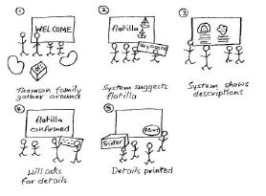
Generating Storyboards from Scenarios
USING PROTOTYPES
IN DESIGN
The second thing to notice is that some of these events are focused solely on the travel organizer’s screen and some are concerned with the environment.
Therefore we could produce a storyboard that focuses on the screens or one that is focused on the environment.
In this case, for example we choose draw a storyboard that focus on the environment in figure 10.03
Figure 10.03 The storyboards for the travel organizer focusing on environmental issues

Slide 23
Generating Card-Based Prototypes from Use Cases
USING PROTOTYPES
IN DESIGN
When a storyboard focusing on the screens has been developed, this can be translated into a card-based prototype.
Another way to produce a card-based prototype is to generate one from a use case output from the requirements activity.
Based on Use Case For Travel Organizer ( Session 09) , we focus on the visa requirements part of the system.
See Card-based prototypes in Fig. 10.04.

Slide 24
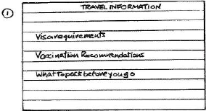
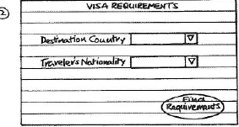
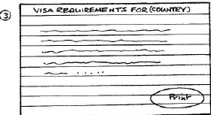
Generating Card-Based Prototypes from Use Cases
USING PROTOTYPES
IN DESIGN
Card 1 covers step 1 Card 2 covers step 2,3,4,5,6,and 7
Card 3 covers step 8,9,10,11
Figure 10.04 Cards one to three

Slide 25
SUPPORT FOR DESIGN
There are different kinds of support available for design :
  Design Patterns for interaction design
    Example : Pattern Languages of Programming,
    www. ui.patterns.com
  Open source systems and components
    Example : sourceforge.net
  Tools and Environments
    Example : many types of automated tools for support creative thinking, design sketching, simulation, video capture, library search. Development resource website e.g. iPhone app development.

Slide 26
COLORS
Colors contains :
  Primary color :
    color that cannot be made from a combination of any other color
  Secondary color :
    created from a combination of two primary colors.
  Tertiary color
    combination of three colors (primary or secondary)
Colors can created with additive or subtractive

Slide 27
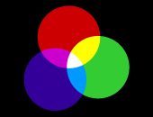
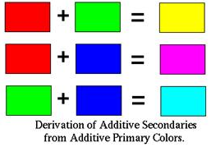
COLORS
Additive Color
  Additive color synthesis is the creation of color by mixing colors of light
Human vision relies on light sensitive cells in the retina of the eye.
There are three types of cone; Red, green, and blue. ( See figure 10.05)
Figure 10.05 Example Additive Color

Slide 28
COLORS
Additive color processes works:
  Generate an image composed of red, green, and blue light
  Since the intensity information for each of the three colors is preserved, the image color is preserved as well
  The spectral distribution of the image will probably be wrong, but if the degree of intensity for each of the primary colors is correct, the image will appear to be the right color.

Slide 29

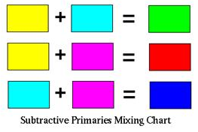
COLORS
Subtractive
Subtractive color synthesis is the creation of color by mixing colors of pigment, printer.
This type of color is what is used in the art and design world like red, yellow, and blue. (See Fig 10.06)
Figure 10.06 Example Subtractive Color

Slide 30
COLORS
Subtractive
Subtractive color processes works:
  Blocking out parts of the spectrum
  The idea of subtractive color is to reduce the amount of undesired color reaching the eye
  For example, you had a yellow image, you would want to have a dye that would let red and green reach the eye, and block out blue.

Slide 31
COLORS
Colour Schemes contains of :
Achromatic
Complementary
Monochromatic
Analogous
Triad

Slide 32
COLORS
Achromatic and Complementary
Achromatic color scheme is one that is colorless using blacks, whites and grays.
Complementary color scheme is one that uses colors directly across from each other on the color wheel can give a bold and dramatic effect, this color scheme is best used for dramatic, strong, or bold statements.
  This can be accomplished by using two colors or hues that are opposites such as red and green or violet and yellow. (See Fig 10.07)
Figure 10.07 Complementary Color Scheme

Slide 33
COLORS
Monochromatic
Monochromatic color scheme is a one-color color scheme.
Colour can be neutralised by adding its complement to lower the intensity of the color.
It is achieved by using one color or hue, utilizing that colors various tints, tones and shades. Black and white can also be used to darken and lighten the value of the color. (See Fig. 10.08)
Using a monochromatic scheme with multiple textures creates character and maintains unity.
Figure 10.08 Monochromatic Color Scheme

Slide 34
COLORS
Analogous
Analogous color scheme is any three adjacent primary, secondary, or tertiary colors on the color wheel. These schemes can be warm or cool.(See Fig. 10.09)
Each can be neutralized by use of its complement, and black and white can be used
Analogous colors "harmonize" well and produce a definite mood to a composition. This can create a very harmonious color scheme.
Figure 10.09 Analogous Color Scheme

Slide 35

COLORS
Triad
Color Triad is a triadic color scheme are colors that are an equal distant from each other on the color wheel.
Any three colors equidistant around the color wheel form a triad and can be used in this color scheme. (See Fig. 10.10)
Figure 10.10 Analogous Color Scheme

Slide 36
REFERENCES
www.cs.virginia.edu/~horton/cs305/slides/prototyping-f08.ppt
http://www.jmu.edu/EnvironmentalInfoSys/ID/L5%20-%20Conceptual%20Design.pdf
http://www.gamasutra.com/blogs/HermanTulleken/20140119/208901/Rapid_Game_Prototyping_Tips_for_Programmers.php
http://ww2.kqed.org/mindshift/2015/02/09/the-benefits-of-paper-prototypes-in-games-and-learning/
https://cs.nyu.edu/courses/fall02/V22.0380-001/color_theory.htm
http://howtonotsuckatgamedesign.com/2014/11/color-theory-game-design-1-fundamentals/

